Slide 1
Nash Bank
Nash, Oklahoma

Slide 10
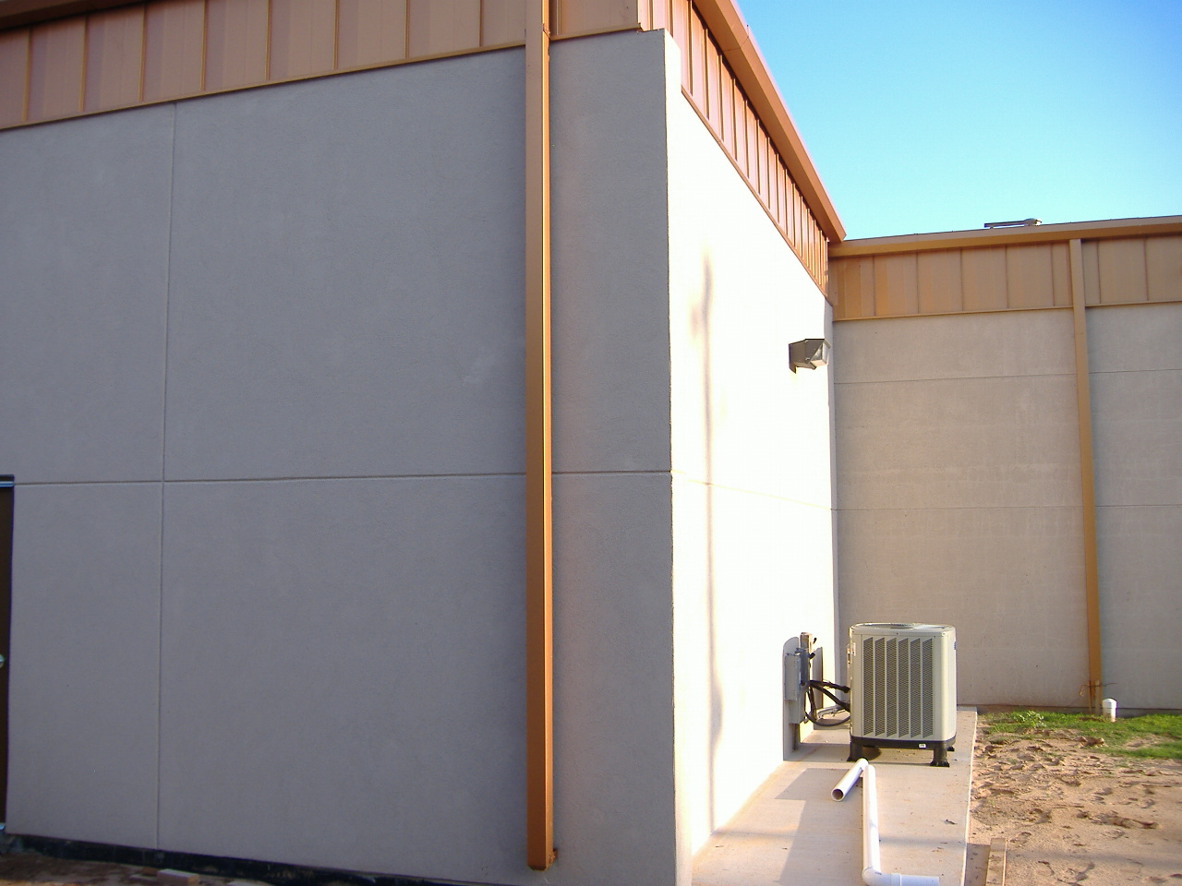

Slide 12
